Slide 1

PROJECT ON TOURS &TRAVELS WEBSITE
BY
R.Priyamvadha(CSD)

Slide 2

T
Travelling around the world is not only for entartainment,it also refreshes our mind, body.

Slide 3
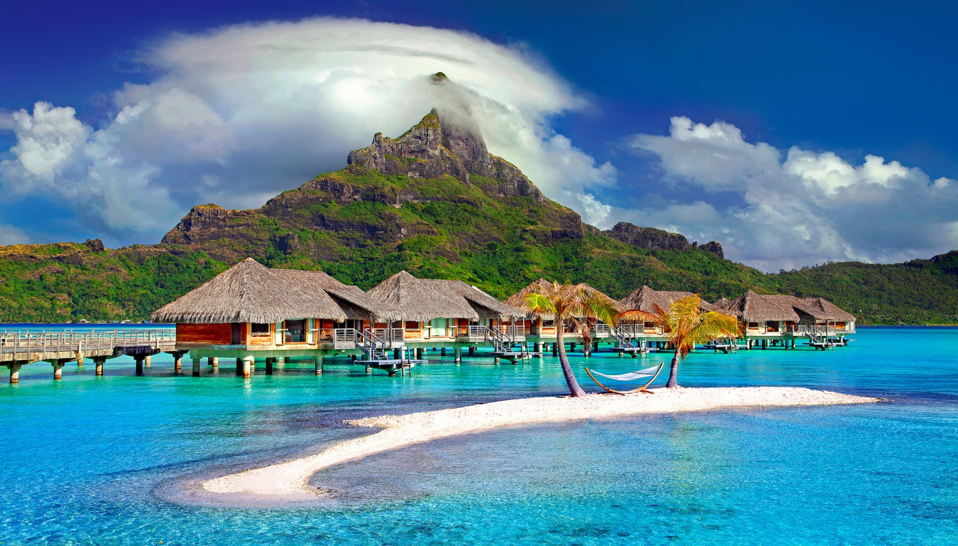
But to travel around the world we don't only need flight/train tickets we also need to be aware of the best place to visit on the particular season,famous tourist attractions,best accomodation to stay ,best tourist guide and many more!!!and with all the best quality facility and with in affordable budget that a common man can afford

Slide 4
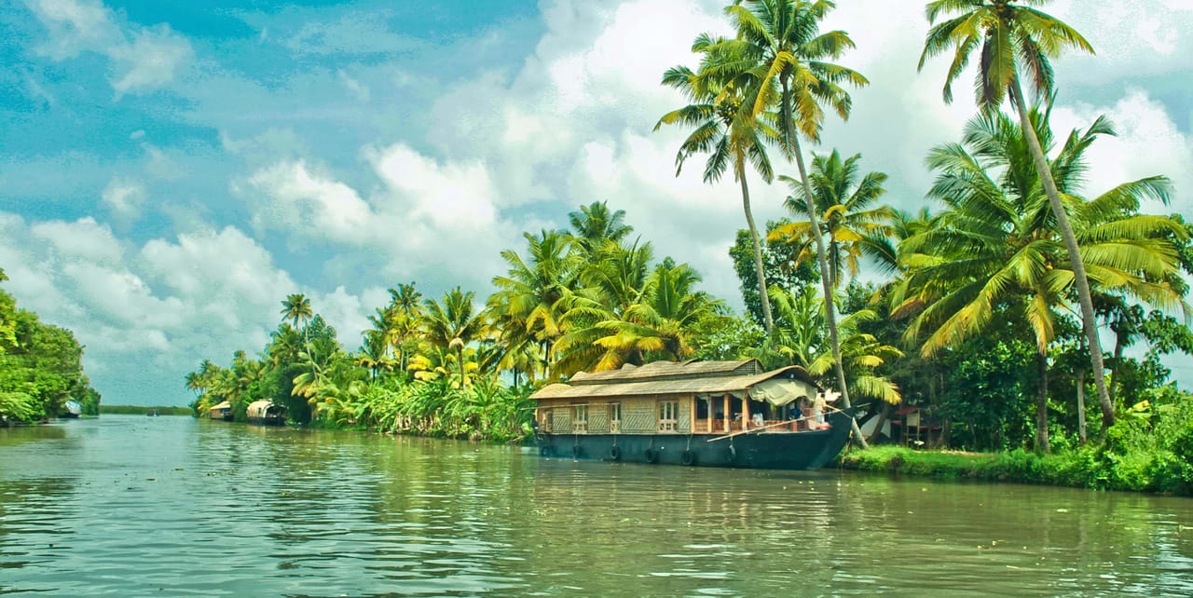
we suggest you the best place to visit on the particular season and understands your mood as like you are a beach person,or a mountain person or a nature lover or a animal lover.

Slide 5
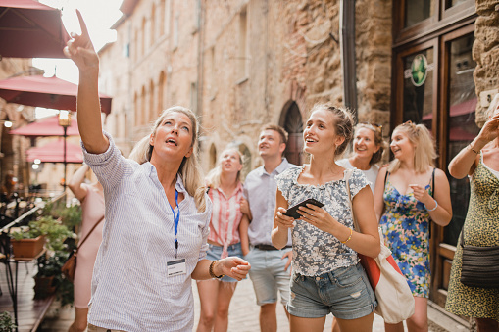
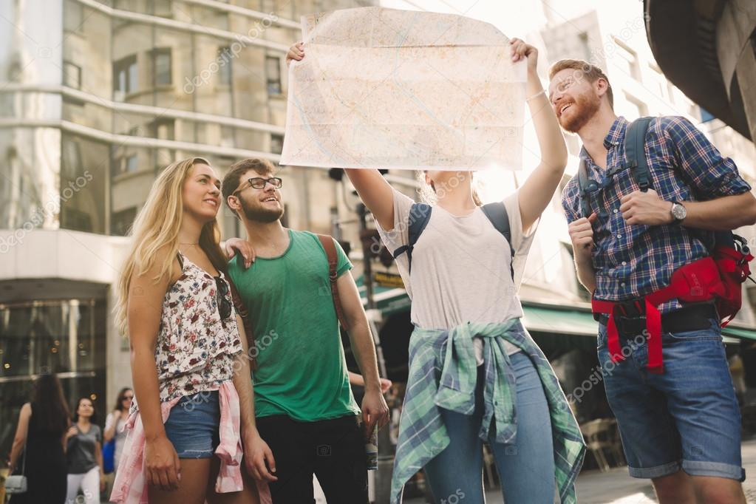
we provide you the best tourist guide,who can aware you about the particular tourist attraction and gives you the idea and speciality of that paricular place.

Slide 6
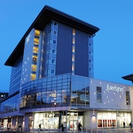
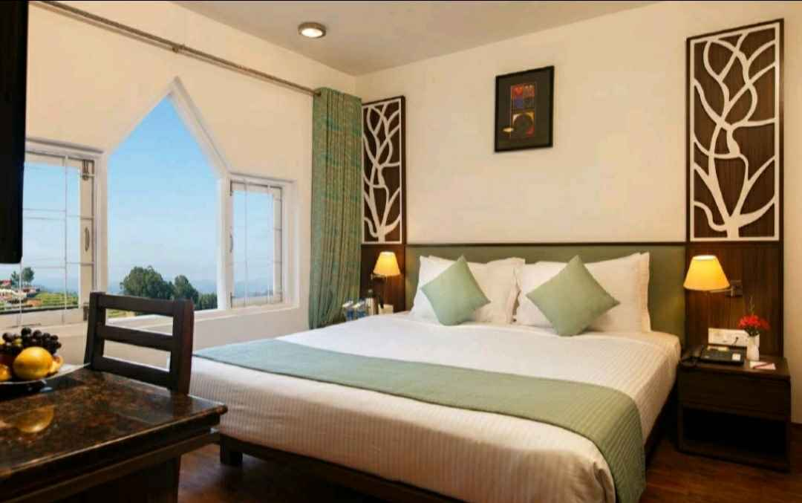

we provide you the best accomodation in 4-star or 5-star hotels in your affordable prices.

